Slide 1
Guiding Principles in Changing Times A Focus on the Dynamic Nature of Career Development
ASPECT Conference
November 5, 2019
Notes:
RIZ – INTRODUCE US AND CERIC

Slide 2
Agenda
Session objectives
Introductions
Opening questions
Setting the context: Trends
8 Guiding Principles: Group discussions
First 4 Principles
Second 4 Principles
Principles in Action
Summary
Closing question
Notes:
RIZ

Slide 3
Session Objectives
Immersive and interactive experience
Put you back in touch with first principles
Explore the dynamic labour market and fluid nature of “career”
Understand the intersection of current trends with CERIC’s Guiding Principles of Career Development
Learn how you can use these principles in your work
Notes:
JOHN

Slide 4
Introductions
Who are you & what do you do?
Notes:
RIZ

Slide 5
Opening Questions
How did you get into this work?
What was the change you wanted to see when you first got into the field? (To vote, go to www.menti.com and use code 15074) Results: https://bit.ly/2oACGiQ
5 years will you still be doing this?
Notes:
JOHN – Q1
RIZ – Q2 - POLL
JOHN – Q3

Slide 6
Video runtime: 3:15 mins
http://bit.ly/2l0WxlQ
Notes:
RIZ – SET SCENE FOR WHY CHOSE VIDEO, ETC.

Slide 7
Trends
Artificial intelligence, technology & jobs
Climate change & resource scarcity
Education & learning
Demographic shifts
Mental health & well-being
Globalized labour mobility & cultural diversity
Notes:
RIZ
What’s exciting about each of these trends and what makes you apprehensive?
JOHN JUMPS IN WITH HIS COMMENTARY

Slide 8
Guiding Principles of Career Development
Notes:
RIZ
With a goal of bringing greater clarity and consistency to our national conversations about career development, CERIC has developed a set of “Guiding Principles of Career Development.” Career professionals are encouraged to use and share this document widely.
These Guiding Principles reflect multiple voices at CERIC and are intended as a starting point to inform discussions with clients, employers, funders, policy-makers and families. The Guiding Principles include an exploration of the word “career” and outline the many benefits of career development.

Slide 9
Guiding Principles of Career Development: Anchored by Evidence
Expert Insights
Research and References
ceric.ca/principles
Notes:
RIZ

Slide 10
Guiding Principles
Career development…
Is a lifelong process of blending and managing paid and unpaid activities: learning (education), work (employment, entrepreneurship), volunteerism and leisure time.
Entails determining interests, beliefs, values, skills and competencies – and connecting those with market needs.
Involves understanding options, navigating with purpose and making informed choices.
Should be self-directed; an individual is responsible for his or her own career, but is not alone – we all influence and are influenced by our environment.
Notes:
JOHN
What does it mean to you personally and to your agency?
Challenge, constraints, opportunities – how do you manage the tensions?
Staffing, funding, service delivery in your agency - transformation
What does it mean for yourself?
When reporting back: what was one common challenge or opportunity that emerged in your table’s discussions?
10

Slide 11
Guiding Principles
Career development…
Is often supported and shaped by educators, family, peers, managers and the greater community.
Means making the most of talent and potential, however you define growth and success – not necessarily linear advancement.
Can be complex and complicated, so context is key – there may be both internal constraints (financial, cultural, health) or external constraints (labour market, technology).
Is dynamic, evolving and requires continuous adaptation and resilience through multiple transitions.
Notes:
RIZ
Switch tables – who is optimistic vs. pessimistic about the future?
11

Slide 12
Summary
Reflect on what you heard throughout the discussion. Which principles are evergreen? Which will be disrupted?
Notes:
JOHN
What is evergreen in the principle vs. what’s likely to change – given current realities vs future trends. What is the disrupter – for example, universal basic income
12

Slide 13
Principles in Action
Using CERIC’s new “Career Work in Action” materials
Notes:
RIZ
CERIC is just launching materials to support the Guiding Principles: 6 Action Plans that help you incorporate these principles into your work depending on your client group: Educated and Underemployed; Newcomers; Post-Secondary; Transition to Retirement; Long Term Unemployed; Youth.
13

Slide 14
Principles in Action
Situating who you are working with
How do they align with each principle
The Organic Career Support Framework
Suggested Discussions and Activities
Self Exploration
Decision Making
Support Through Transition
Future Thinking
Mental Health
Appendices
Notes:
RIZ
Overview of the major sections of the Action Plan document
14

Slide 15
Principles in Action
…Let’s do some of the Completion Exercise
Notes:
JOHN
Pick 1 question from #1 – 3; 3 minutes to reflect and write down. Ask 5 people to share an insight “on career acknowledgements”
Pick 1 question from #4 – 6; 3 minutes to reflect and write down. Ask 5 people to share an insight “on their past experience”
Pick 1 question from #7 – 10; 3 minutes to reflect and write down. Ask 5 people to share an insight “on the bigger question”
15

Slide 16
Principles in Action
Possible Next Steps:
Once you’ve worked through these questions and processed anything that needed attention, you may want to create some kind of completion ritual, e.g. throwing your notes in a bonfire or creating a visual display of some of your positive insights. Perform your ritual when you feel internally ready to let go. A ritual is the end point at which you say, “I’m ready to let go and move on.”
Notes:
RIZ
Reiterate there are 6 such Plans and each downloadable for free.
16

Slide 17
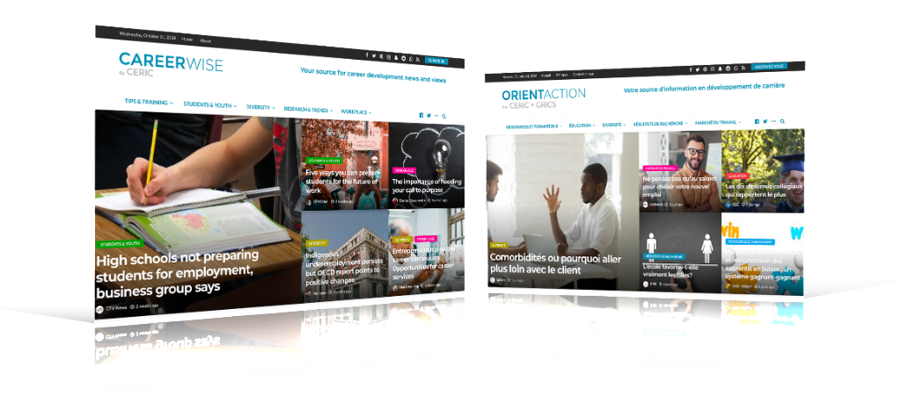
Trend Resources
Artificial Intelligence - https://careerwise.ceric.ca/
Notes:
JOHN
Example – reports we share on our CareerWise website and popular CareerWise Weekly newsletter: Turn and Face the Strange: Changes impacting the future of employment in Canada (Brookfield Institute)
This report sets out to illuminate the diverse and intersecting trends driving change in Canada’s labour market. These trends have the potential to influence future skills demand in either positive or negative ways – and sometimes both.
Relating to technological change it explores trends including:
AI EVERYTHING: AI may impact and potentially disrupt every industry.
VR + AR EXPERIENCES: Virtual and Augmented Reality may transform the way Canadians engage with a range of experiences, including training 3D PRINTING: 3D printing is gearing up to change the way we produce and consume goods in the future
TECHNOLOGICAL FEAR: The pervasiveness of our digital connections is leading to deep fear and anxiety about technology

Slide 18
Trend Resources
Climate Change – www.ceric.ca/careering
Notes:
CERIC’s current issue Careering magazine for practitioners tackles climate change and its impact on careers.
A topical issue – with Greta Thunberg just in Vancouver last week
This edition of the magazine examines the intersection of climate change and employment from many different angles. Articles explore employment trends, the effect of extreme weather on environmental professions, industries in transition such as agriculture and energy, the link between youth career education and climate change.

Slide 19
Trend Resources
Learning – www.ceric.ca/webinars
Notes:
JOHN
Webinars that CERIC offers – both free and paid – are a good example of the trend towards micro-learning. Just on Monday (meaning Monday, Nov 4) we wrapped up our latest series of free webinars with the authors of our free Career Theories and Models at Work book. The book features 43 theories and models and focuses on how you can apply them in practice with your clients. These webinars are each one hour in length and the recordings can be accessed on CERIC’s site

Slide 20
Trend Resources
Demographics www.ceric.ca/redirection
Notes:
RIZ
Could also reference Seniorpreneur research

Slide 21
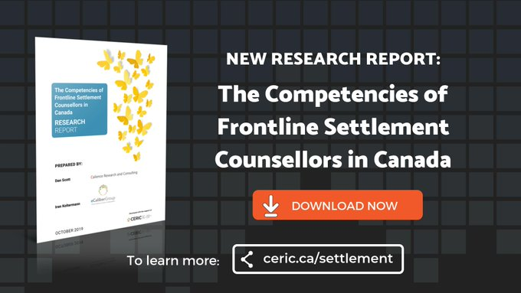
Trend Resources
Cultural Diversity www.ceric.ca/settlement
Notes:
RIZ
There is a pressing need for greater training of settlement counsellors – those on the front lines of welcoming newcomers to Canada – as their role changes in response to rising immigration levels and an increasingly complex settlement landscape, according to a new CERIC-funded project research report. The pan-Canadian research identifies eight critical competencies that could form the basis of training to help settlement counsellors be successful as the job is redefined and the range of work is extended

Slide 22
Trend Resources
Mental Health – www.ceric.ca/projects
Notes:
JOHN
CERIC is funding a new project that will produce a guide for career practitioners that addresses their role in supporting or improving client mental health and potentially preventing or reducing the severity of mental illness. The project’s main objective is the dissemination of current research and thinking regarding career development practice and its impact on mental health combined with practical suggestions for enhancing this impact. Led by Life-Role Development Group Ltd., with the support of Simon Fraser University and the Career Education Association of Victoria (CEAV), Australia, this resource will provide the language and evidence that career development interventions can have positive mental health outcomes. The guide will be launching at CERIC’s Cannexus National Career Development Conference in Ottawa in January where everyone will receive a copy.
CERIC’s early resource the Career Services Guide to Supporting People Affected by Mental Health Issues – is our top downloaded resource, attesting to the interest in this subject.

Slide 23
Closing Question
What’s the change you want to see now (based on your experience and the emerging trends)?
(To vote, go to www.menti.com and use code 15074) Results: https://bit.ly/2oACGiQ
Notes:
RIZ

Slide 24
Thank You!
ceric.ca/principles
Notes:
RIZ

Slide 25
Contact Us
CERIC
Foundation House
2 St Clair Avenue East, Suite 300 Toronto, Ontario M4T 2T5
T: 416. 929. 2510
E: admin@ceric.ca
ceric.ca
Connect with us:
ceric.ca/linkedin
ceric.ca/twitter
ceric.ca/facebook
ceric.ca/youtube
Notes:
RIZ

